Slide 1
Python for data analyse drug comsumption
Tiberio Zolzettich
Keziah Tabassomi
Notes:
1

Slide 2

Table of content
08/12/2023
2
Python for data analyse
Presentation of the database
Data preprocessing
Data visualization
Data modelling
WebApp & API
Notes:
2

Slide 3
Presentation of the database
Source : https://archive.ics.uci.edu/dataset/373/drug+consumption+quantified
Notes:
4

Slide 4
Features
12 personnal informations
19 consumption frequency
Age range
Gender
Level of education
Country
Ethnicity
Neuroticism score
Extraversion score
Openness to experience score
Agreeableness score
Conscientiousness score
Impulsivity score
sensation seeking score
Alcohol
Amphetamines
amyl nitrite
Benzodiazepine
Cannabis
Chocolate
Cocaïne
Caffeine
Crack
Ecstasy
Heroin
Ketamine
legal highs
LSD
Methadone
Mushrooms
Nicotine
Volatile substance abuse
There are 1885 individuals in this dataset
5
Notes:
5

Slide 5
Data preprocessing
Notes:
3

Slide 6
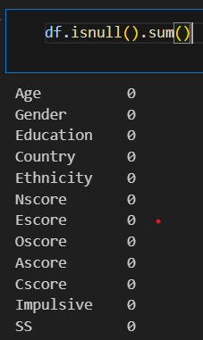
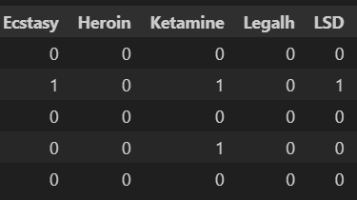
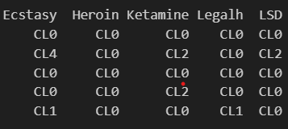
Preprocessing
I. No missing values
II. Replacing string by integer
0 correspond to "Never Used", "Used over a Decade Ago" and 1 correspond to all other classes
4
Notes:
4

Slide 7
Data visualization
Notes:
5

Slide 8
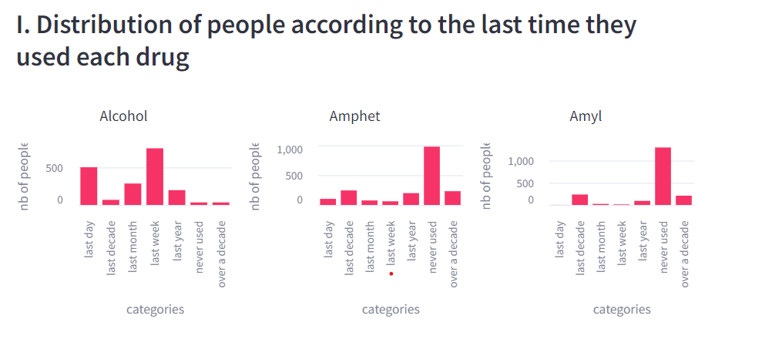
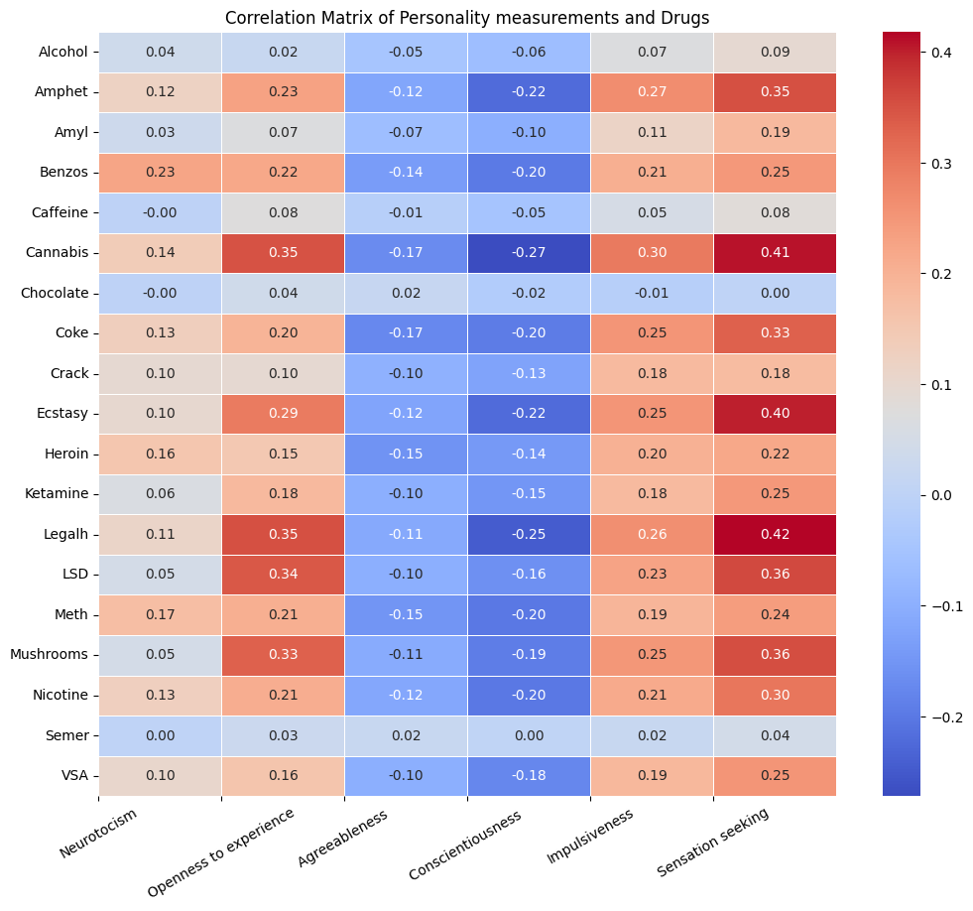
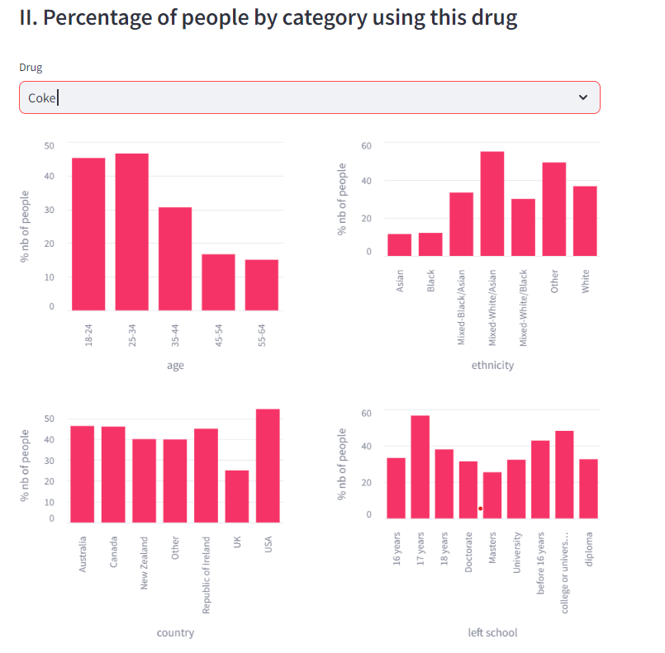
8
Notes:
8

Slide 9
Data Modeling
Notes:
7

Slide 10
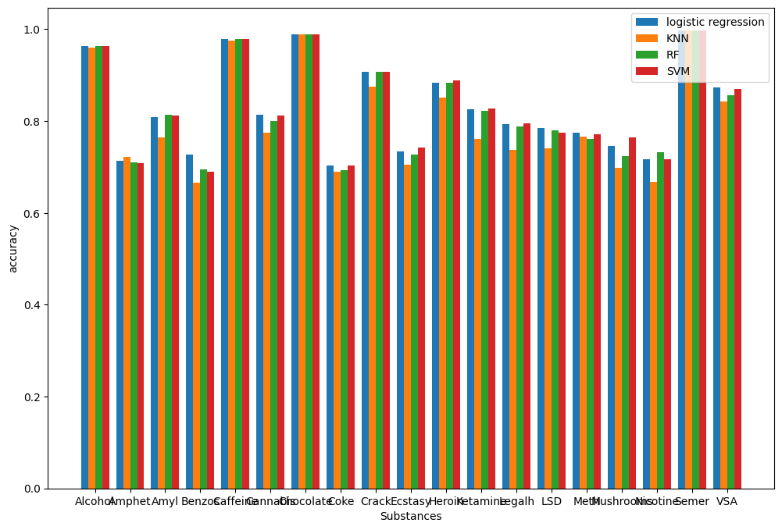
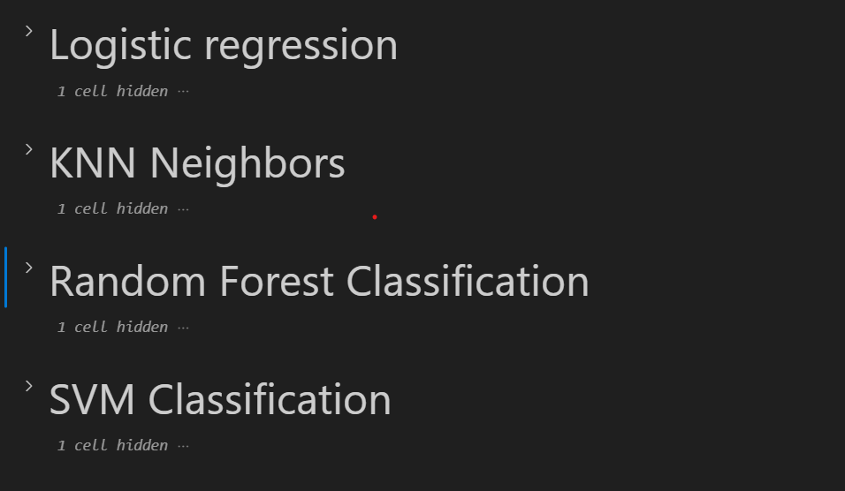
6
Notes:
6

Slide 11
Webapp & api
Notes:
9

Slide 12
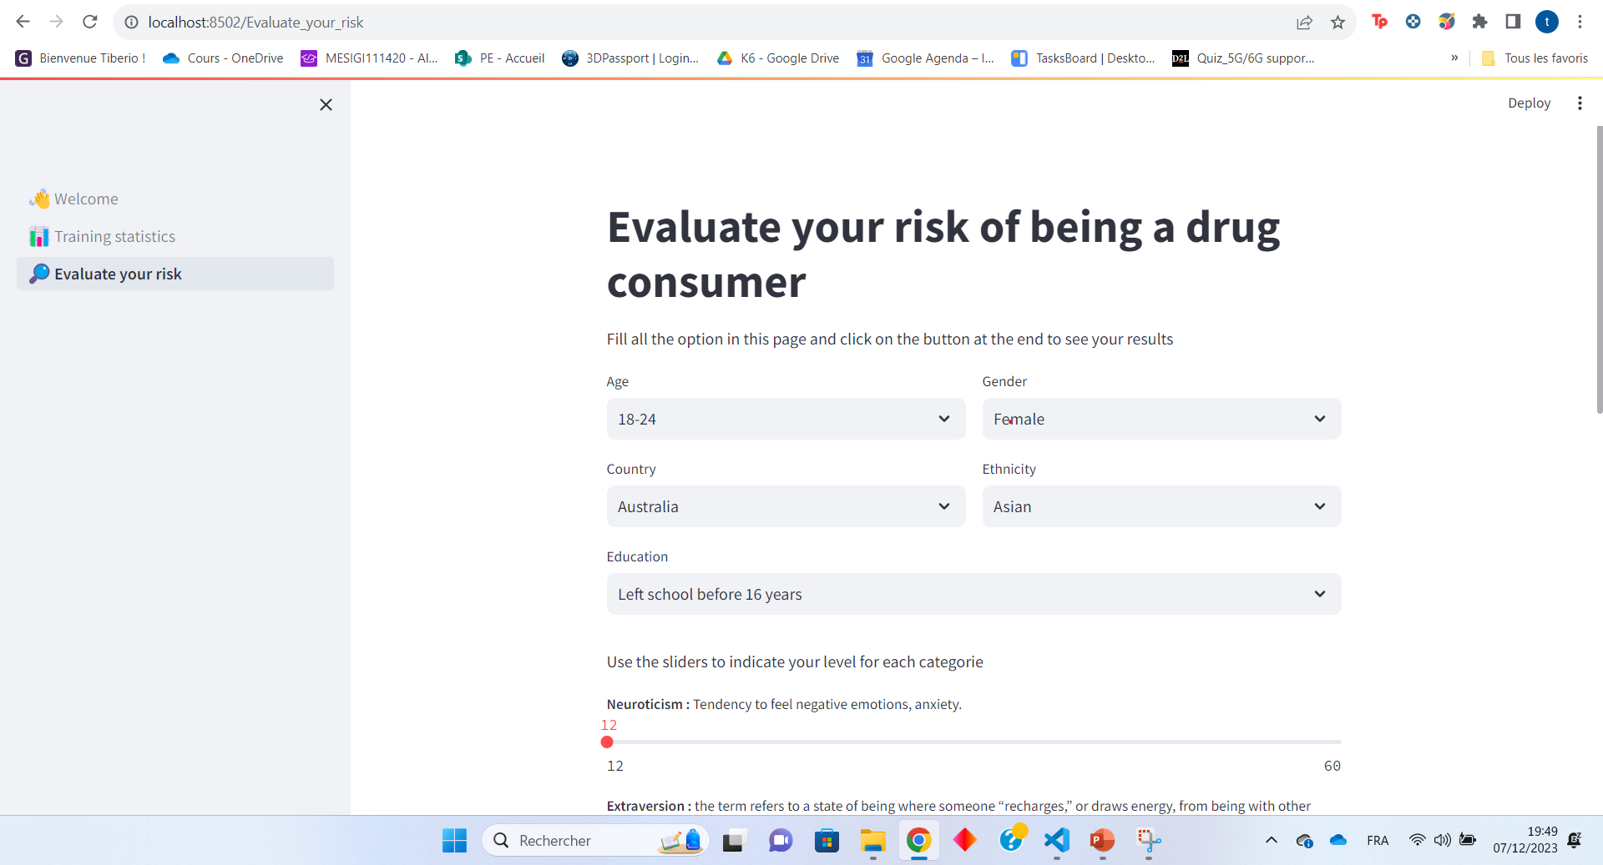
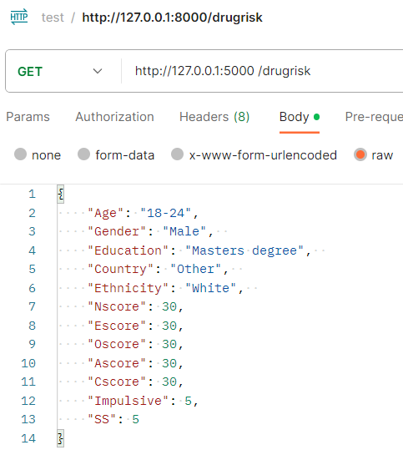
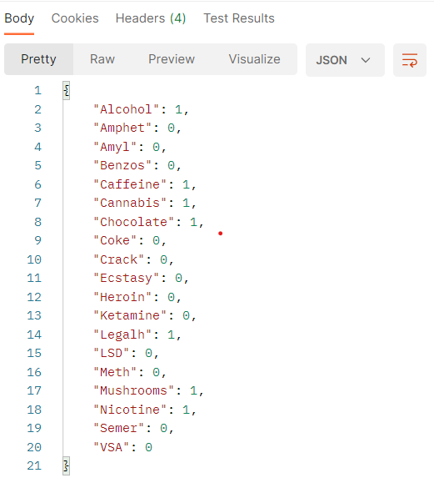
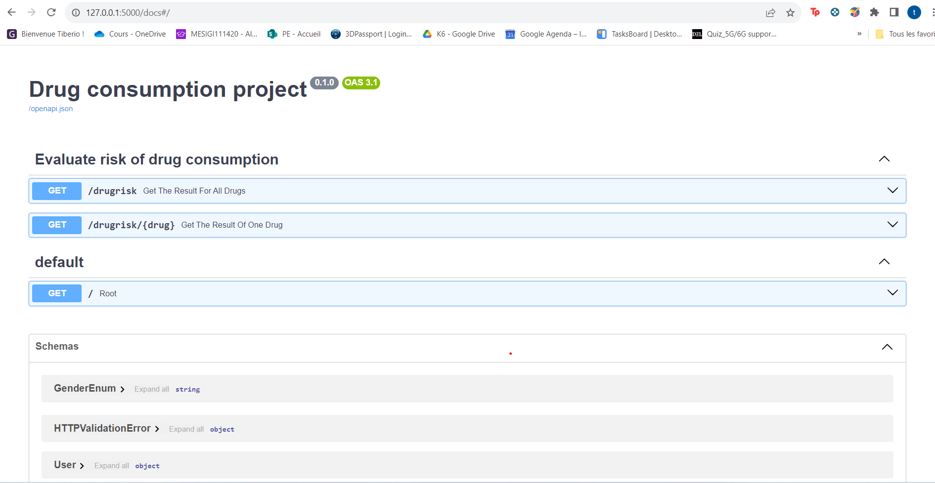
WebAPP
Query
Response
Doc
API
10
Notes:
10

Slide 13




Merci
13
Python for data analyse
Notes:
13

